Slide 1













Mount Pleasant Lane
SCHOOL COUNCIL
2026 - 2027

Slide 2


OUR SCHOOL VALUES
We are kind.
We are brave.
We are responsible.
We are learners.

Slide 3
WHAT IS A SCHOOL COUNCIL?
They help to make our school even better.
They listen to ideas and share them with teachers and leaders.
A group of pupils chosen to represent their classes.

Slide 4


WHY DO WE HAVE A SCHOOL COUNCIL?
To show leadership and teamwork.
To give every pupil a voice.
To help improve our school.
To live our school values every day.
To have fun!

Slide 5




MPL SCHOOL VALUES
WE ARE RESPONSIBLE
WE ARE LEARNERS
WE ARE KIND
WE ARE BRAVE

Slide 6
WHAT SCHOOL COUNCILLORS DO
Share pupil voice with school leaders.
Act as a role model throughout the school.
Collect ideas and suggestions.
Help with projects and events.
Lead class discussions.

Slide 7



INFORMATION
LUNCH PASSES
OPAL REPS
BADGES
School Council meetings will take place at 12.30 pm each Friday with Mrs Lakhani.
Each class will also have one OPAL rep to share ideas about outdoor play.
School Counsellors will get special badges to wear so everyone knows who they are.

Slide 8


EYFS APPLICATIONS

Slide 9
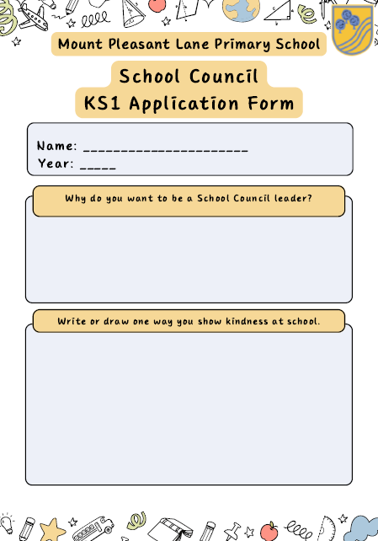
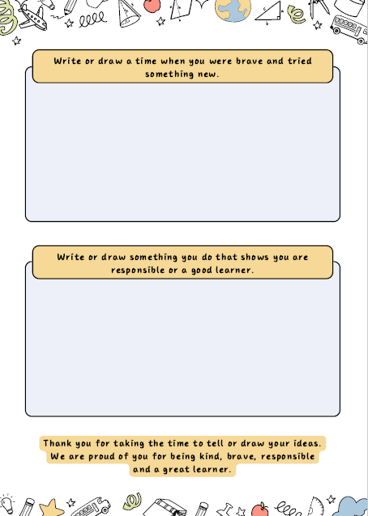
KEY STAGE 1 APPLICATIONS

Slide 10
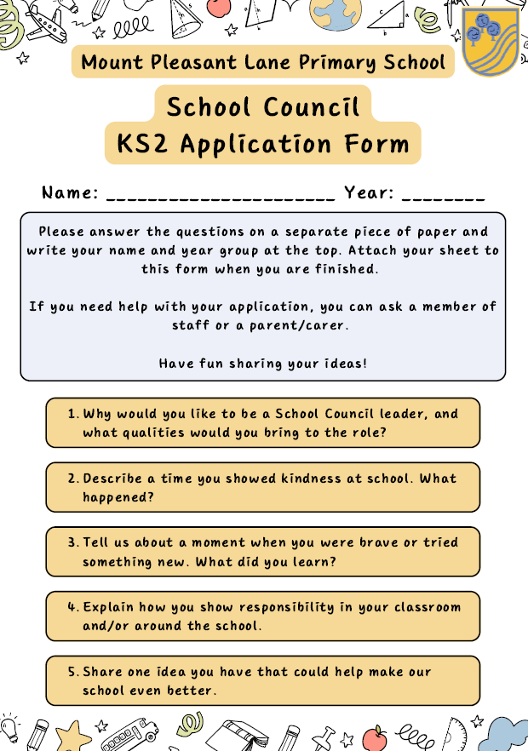
KEY STAGE 2 APPLICATIONS

Slide 11






KEY DATES - THIS WEEK
MONDAY
THIS WEEK
FRIDAY
Please hand your completed form to your classroom teacher by Friday.
Your teacher will hand out the application forms.
Children who would like to apply can complete a form.

Slide 12

KEY DATES - NEXT WEEK
MONDAY
THIS WEEK
FRIDAY
Our first School Council meeting will take place on Friday at 12.30 pm.
We will vote on Monday in the school hall.
The School Council will be announced on Tuesday.

Slide 13
Let’s have a
GREAT YEAR!

